Slide 1
Chapter 17: Enhancing Presentations With Slides and Other Visuals (2)
Book: Business Communication Today (14ed.)
Authors: Bovee, Thill and Raina

Slide 2
Creating Effective Slide Content
Writing Readable Content
Creating Charts and Tables for Slides
Adding Animation and Multimedia
a. Functional Animation
b. Transitions
c. Builds
d. Hyperlinks
e. Multimedia Elements

Slide 3
1. Writing Readable Content
Do not stuff slides with too much text. Doing so overloads audience with too much information, diverts attention from presenter by forcing people to read more.
Choose words and short phrases, without forcing audience to read in depth.
You want your audience to listen not to read.
Provide additional important information/ details in handouts.

Slide 4
1. Writing Readable Content…
When writing content for text slides keep the following points in mind.
Limit each slide to one concept, idea or thought.
Limit text content to four or five lines per slide. This limit can be exceeded but not so frequently.
Do not show large number of text heavy slides in a row, give audience some visual relief.
Write short phrases rather than long sentences.

Slide 5
1. Writing Readable Content…
5. Use sentence only when you need to share a quotation or a definition.
6. Use active voice.
7. Include short, informative titles.
8. When using visuals with text, the more information the visual can convey, the less work your text needs to do.

Slide 6
Creating Effective Slide Content
Writing Readable Content
Creating Charts and Tables for Slides
Adding Animation and Multimedia
a. Functional Animation
b. Transitions
c. Builds
d. Hyperlinks
e. Multimedia Elements

Slide 7
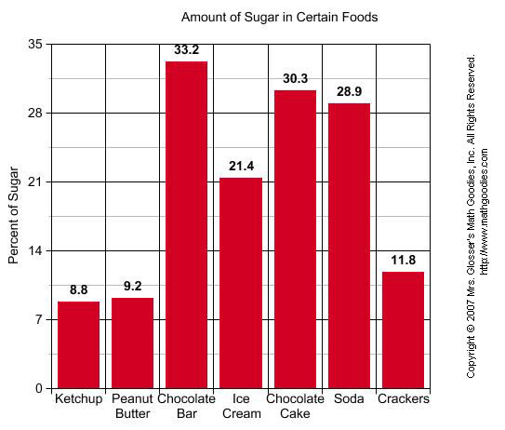
2. Creating Charts and Tables for Slides
Charts and tables for presentations need to be simpler than visuals for printed documents.
Reduce detail.
Simplify charts and tables. For
example in a bar chart show values
above each bar.

Slide 8
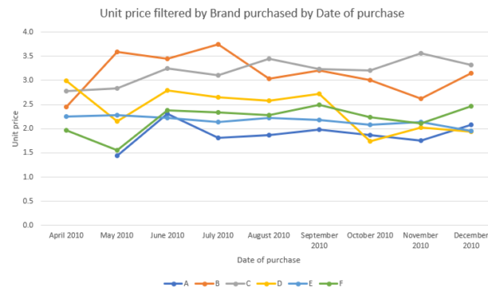
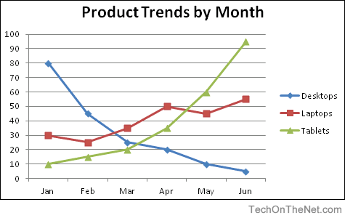
2. Creating Charts and Tables for Slides . . .
3.Limit the amount of data shown.
3(a). Line charts look busy when they have more than two or three lines.

Slide 9
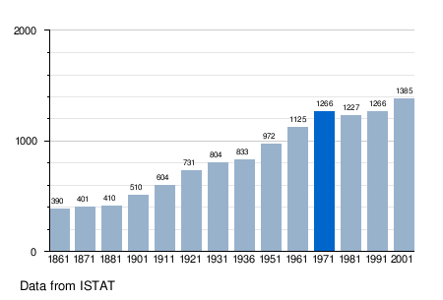
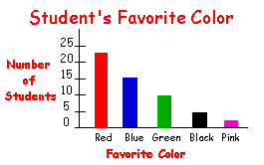
3(b). Bar charts look crowded with more than five or six bars.

Slide 10
4. Shorten numbers. Round off numbers such as $12,500.72 to $12.5 and then label the axis to indicate thousands.
5. Highlight key points in a visual you use. Use arrows, boldface or clour to guide your audience to the main point.
6. Adjust the size of your visual to accommodate the size of a slide. Leave enough white space.

Slide 11
Creating Effective Slide Content
Writing Readable Content
Creating Charts and Tables for Slides
Adding Animation and Multimedia
a. Functional Animation
b. Transitions
c. Builds
d. Hyperlinks
e. Multimedia Elements

Slide 12
3.Adding Animation and Multimedia
1. Functional Animation
Do not use decorative animation.
Use functional/ effective animation.
2. Transitions
How one slide replaces another on screen.
3. Builds
These effects control the release of text, graphics and other elements on screen.
Control the release of bullet points on screen.

Slide 13
4. Hyperlinks
A hyperlink helps to jump to a website.
It gives a linear presentation a feel of non-linear presentation.
https://www.youtube.com/watch?v=Hqw0PzOTqOY
5. Multimedia Elements
a. Use audio and video clips.

Slide 14
Creating Effective Handouts
Handouts : Any printed material you give the audience to supplement your talk.
Do not worry about stuffing every detail into your slides.
Handouts may contain the following materials:
Complex Charts and Diagrams
Articles and Technical Papers
Case Studies
Recommended Resources
Copies of Presentation Slides

Slide 15
Timing the distribution of handouts (before or after the presentation) depends on:
Their content
The nature of your presentation
Your personal preference

